Slide 1
Decision Tree

Slide 2

Decision Tree Overview
A decision tree is a decision support tool that uses a tree-like graph or model of decisions and their
possible consequences, including chance event outcomes, resource costs, and utility. It is one way to
display an algorithm that only contains conditional control statements
A decision tree is a flowchart-like structure in which each internal node represents a “test” on an attribute (e.g. whether a coin flip comes up heads or tails), each branch represents the outcome of the test, and each leaf node represents a class label (decision taken after computing all attributes). The paths from root to leaf represent classification rules.
Tree based learning algorithms are considered to be one of the best and mostly used supervised learning methods. Tree based methods empower predictive models with high accuracy, stability and ease of interpretation. Unlike linear models, they map non-linear relationships quite well. They are adaptable at solving any kind of problem at hand (classification or regression). Decision Tree algorithms are referred to as CART (Classification and Regression Trees)
To imagine, think of decision tree as if or else rules where each if-else condition leads to certain answer at the end.

Slide 3
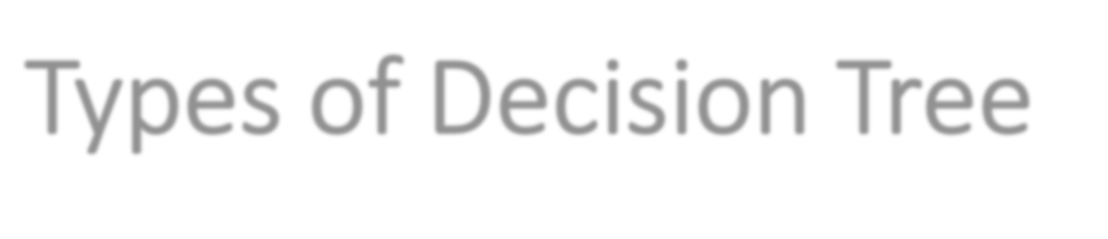
Types of Decision Tree
Types of decision tree is based on the type of target variable we have. It can be of two types:
1.Categorical Variable Decision Tree: Decision Tree which has categorical target variable then it called as categorical variable decision tree. Example:- In scenario of student problem, where the target variable is “Student will play cricket or not” i.e. YES or NO.
1.Continuous Variable Decision Tree: Decision Tree has continuous target variable then it is called as Continuous Variable Decision Tree. Example :- price of a newly launched product because price can be anything depending on various constraints.

Slide 4
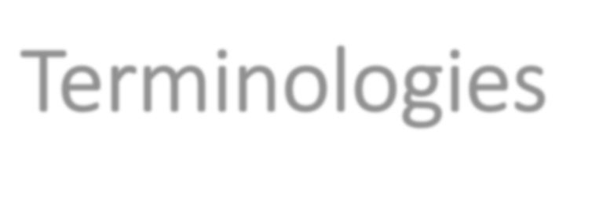
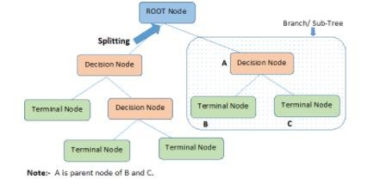
Terminologies
Important Terminology related to Tree based Algorithms
1: Root Node: It represents entire population or sample and this further gets divided into two or more homogeneous sets.
2: Splitting: It is a process of dividing a node into two or more sub-nodes.
3: Decision Node: When a sub-node splits into further sub-nodes, then it is called decision node.
4: Leaf/ Terminal Node: Nodes do not split is called Leaf or Terminal node.

Slide 5
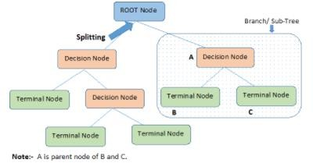
Terminologies
5: Pruning: When we remove sub-nodes of a decision node, this process is called pruning. You can
say opposite process of splitting.
6: Branch / Sub-Tree: A sub section of entire tree is called branch or sub-tree.
7: Parent and Child Node: A node, which is divided into sub-nodes is called parent node of sub- nodes where as sub-nodes are the child of parent node.

Slide 6
Classification Tree vs Regression Tree
Classification Tree
Classification trees are used when dependent
variable is categorical.
Regression Tree
Regression trees are used when dependent variable is continuous.
In case of classification tree, the value (class) obtained by terminal node in the training data is the mode of observations falling in that region. Thus, if an unseen data observation falls in that region, we’ll make its prediction with mode value
In case of regression tree, the value obtained by terminal nodes in the training data is the mean response of observation falling in that region. Thus, if an unseen data observation falls in that region, we’ll make its prediction with mean value.

Slide 7
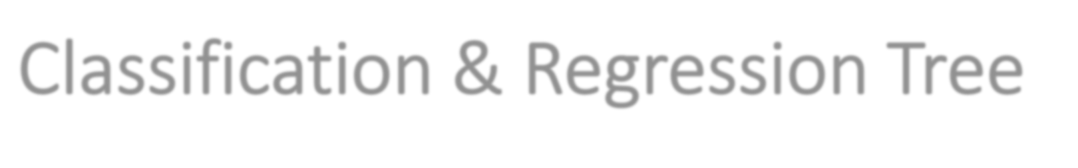
Classification & Regression Tree
Both the trees follow a top-down greedy approach known as recursive binary splitting. We call it as ‘top- down’ because it begins from the top of tree when all the observations are available in a single region and successively splits the predictor space into two new branches down the tree. It is known as ‘greedy’ because, the algorithm cares (looks for best variable available) about only the current split, and not about future splits which will lead to a better tree.
This splitting process is continued until a user defined stopping criteria is reached. For example: we can tell
the algorithm to stop once the number of observations per node becomes less than 50.
In both the cases, the splitting process results in fully grown trees until the stopping criteria is reached. But, the fully grown tree is likely to overfit data, leading to poor accuracy on unseen data. This bring ‘pruning’. Pruning is one of the technique used tackle overfitting.

Slide 8
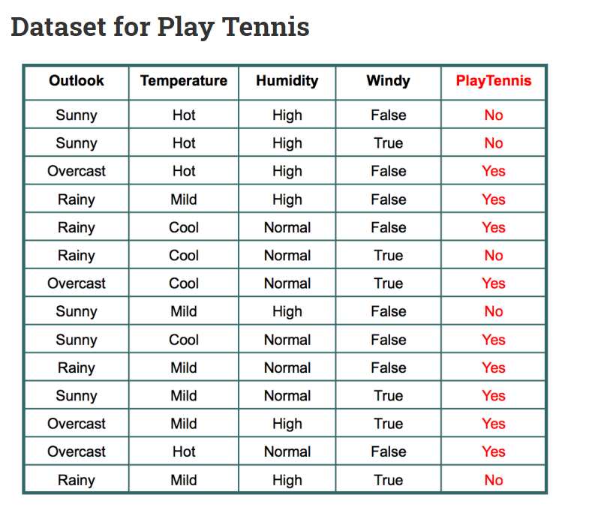
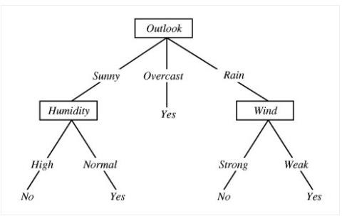
Example

Slide 9
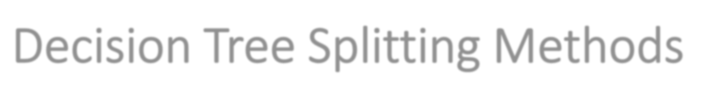
Decision Tree Splitting Methods
There are multiple ways of doing this, which can be broadly divided into two categories based on the type of target variable:
Continuous Target Variable
Reduction in Variance
Categorical Target Variable
Gini Impurity
Information Gain
Chi-Square

Slide 10

Gini Impurity
Gini says, if we select two items from a population at random then they must be of same class and probability for this is 1 if population is pure.
1.It works with categorical target variable “Success” or “Failure”. 2.It performs only Binary splits
Higher the value of Gini higher the homogeneity.
CART (Classification and Regression Tree) uses Gini method to create binary splits.

Slide 11


Gini Impurity
Gini Impurity is a method for splitting the nodes when the target variable is categorical. It is the most popular and the easiest way to split a decision tree. The Gini Impurity value is:
Where Gini is the probability of correctly labelling a randomly chosen element if it was randomly labelled according to the distribution of labels in the node. The formula for Gini is:
Hence,
** Lower the Gini Impurity, higher is the homogeneity of the node. The Gini Impurity of a pure node is zero.

Slide 12
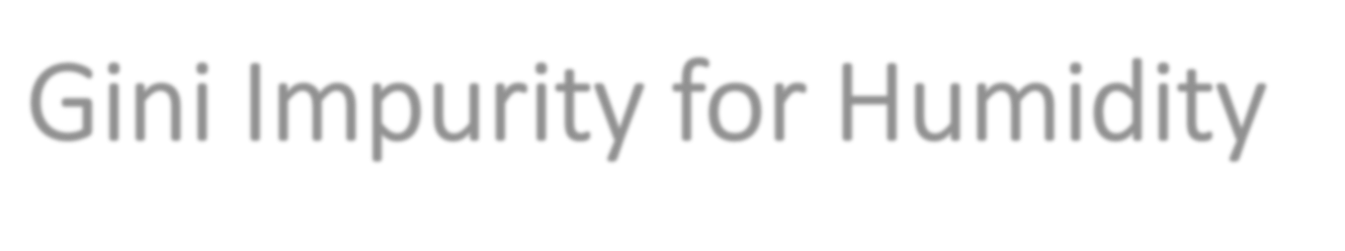
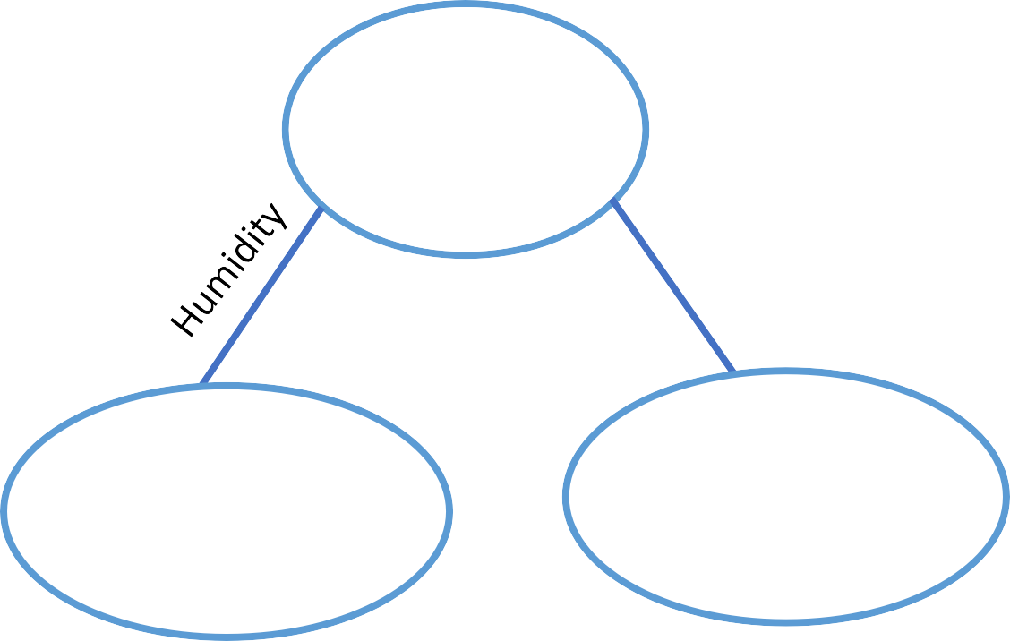
Gini Impurity for Humidity
Gini for Humidity (High)= (0.42)^2+(0.58)^2= 0.1764+0.3364
=0.5128
Gini for Humidity (Normal)= (0.85)^2+(0.15)^2= 0.7225+0.0225
=0.745
Total Students =14 Play tennis=9 Percentage=64.28%
Weighted Gini for Humidity=(7/14)* 0.5128 +(7/14)* 0.745
=0.6289
Gini Impurity for Humidity =1- 0.6289
=0.3711
Total Students =7 Play tennis=6
% play tennis=0.85
% Not play tennis=0.15
Total Students =7 Play tennis=3
% play tennis=0.42
% Not play tennis=0.58
High
Normal

Slide 13
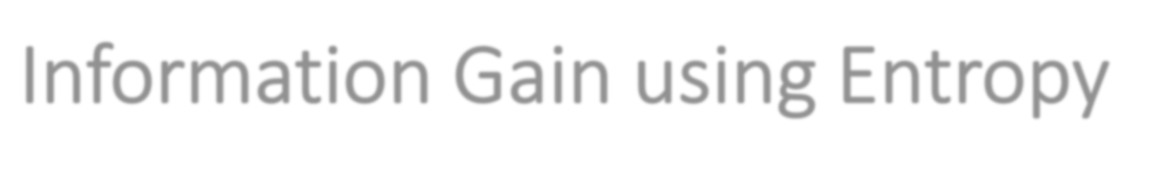
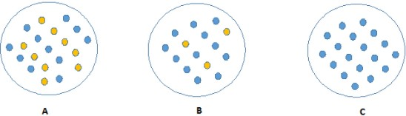
Information Gain using Entropy
Information theory is a measure to define this degree of disorganization in a system known as Entropy. If the sample is completely homogeneous, then the entropy is zero and if the sample is an equally divided (50% – 50%), it has entropy of one.
Consider below image, C requires less information to describe as all values are similar. On the other hand, B requires more information to describe it and A requires the maximum information. In other words, we can say that C is a Pure node, B is less Impure and A is more impure.

Slide 14
Information Gain using Entropy
Entropy can be calculated using formula:-
Here p and q is probability of success and failure respectively in that node. Entropy is also used with categorical target variable. It chooses the split which has lowest entropy compared to parent node and other splits. The lesser the entropy, the better it is.
Information gain is given by-
Information Gain=entropy of source – entropy of branches

Slide 15
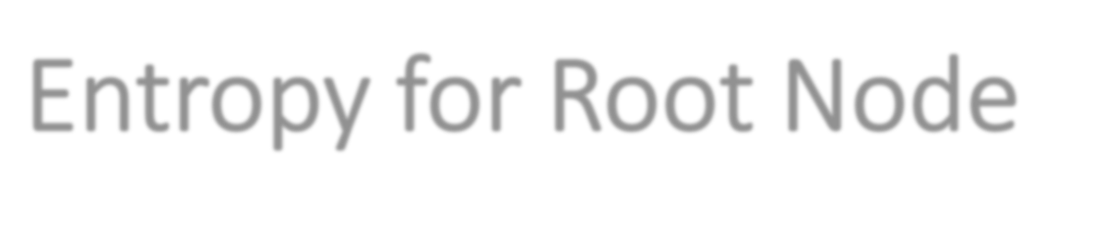
Entropy for Root Node
Entropy=-0.64*log(0.64)-0.36*log(0.36)
=-0.64*-0.6438-0.36*-1.4739
=0.4120+0.5306
=0.94
Total Students =14 Play tennis=9
% play tennis=0.64
% Not play tennis=0.36

Slide 16
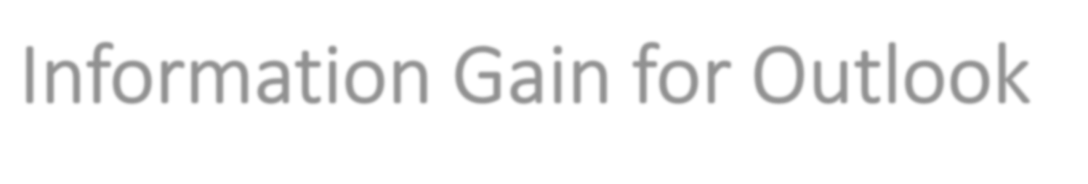
Information Gain for Outlook
Entropy for Outlook (Sunny)= -(0.4) log(0.4)-(0.6)log(0.6)
=-(0.4)*-1.3219-(0.6)*-0.7369
= 0.5287+0.4417
=0.97
Total Students =14 Play tennis=9 Percentage=64.28%
Entropy for Outlook (Overcast)= -(1) log(1)-(0)log(0)
=-(1)*0-0
= 0
Rainy
Sunny
Entropy for Outlook (Rainy)= -(0.4) log(0.4)-(0.6)log(0.6)
=0.9764
Total Students =5 Play tennis=3
% play tennis=0.6
% Not play tennis=0.4
Total Students =5 Play tennis=2
% play tennis=0.4
% Not play tennis=0.6
Weighted Entropy for Outlook=0.3571*0.9764+0.2857*0+0.3571*0.9764
=0.3486+0.3486
=0.69
Information Gain=entropy source – entropy of branches
= 0.94- Weighted Entropy
=0.94-0.6972
=0.25
Total Students =4 Play tennis=4
% play tennis=1
% Not play tennis=0
Overcast
Outlook

Slide 17
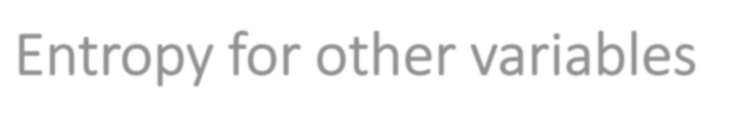
Entropy for other variables
Temperature:
Information Gain = 0.029
Windy:
Information Gain = 0.048
Humidity:
Information Gain = 0.152
.
We can see that decrease in randomness, or information gain is most for Outlook. So, we choose first decision maker as Outlook

Slide 18
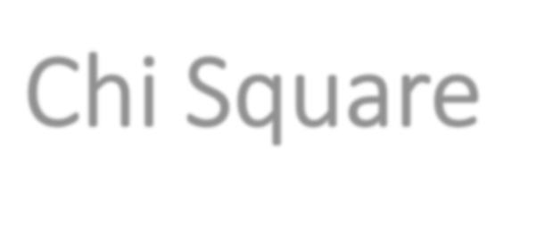

Chi Square
It is an algorithm to find out the statistical significance between the differences between child - nodes and parent node. We measure it by sum of squares of standardized differences between observed and expected frequencies of target variable.
Chi-Square value is
Here, the Expected is the expected value for a class in a child node based on the distribution of classes in the parent node, and Actual is the actual value for a class in a child node.
The above formula gives us the value of Chi-Square for a class. Take the sum of Chi-Square values for all the classes in a node to calculate the Chi-Square for that node. Higher the value, higher will be the differences between parent and child nodes, i.e., higher will be the homogeneity.

Slide 19
Chi Square
Steps to calculate Chi – Square
For each split, individually calculate the Chi-Square value of each child node by taking the sum of Chi- Square values for each class in a node
Calculate the Chi-Square value of each split as the sum of Chi-Square values for all the child nodes 3.Select the split with higher Chi-Square value
4.Until you achieve homogeneous nodes, repeat steps 1-3

Slide 20
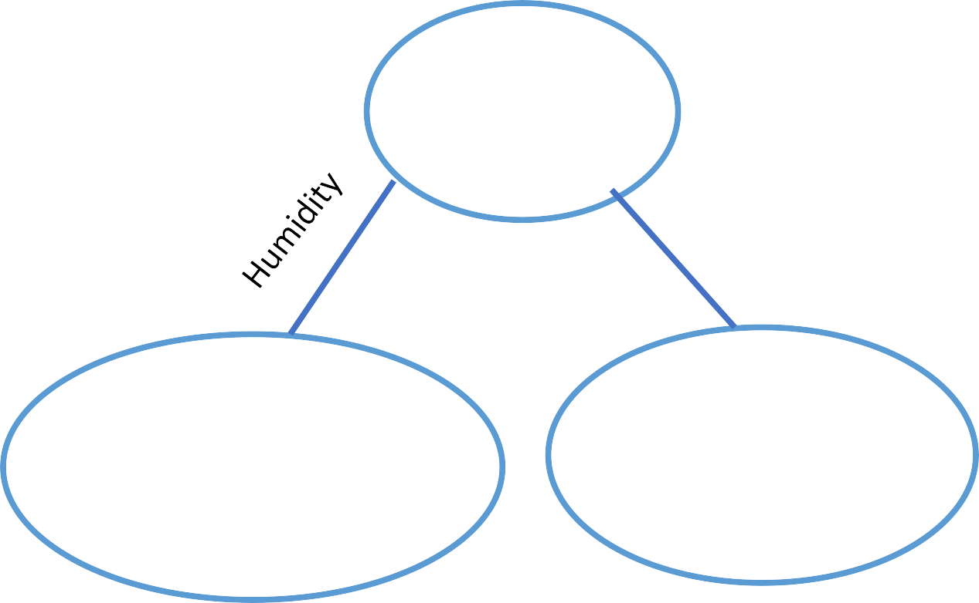
Chi Square
Node | Actual Play | Actual Not play | Expected Play | Expected Not Play | Deviation Play | Deviation Not play | Chi Square Play | Chi square not play
High | 3 | 4 | 5 | 2 | -2 | 2 | 0.89 | 1.41
Normal | 6 | 1 | 5 | 2 | 1 | -1 | 0.44 | 0.70
Total Students =14 Play tennis=9 Not play =5
Total Chi Square = 0.89+0.44+1.41+0.70
=3.45
Total Students =7 Actual Play tennis=3 Expected play tennis=5 Actual Not play tennis=4 Expected not play tennis=2
Total Students =7 Actual Play tennis=6 Expected play tennis=5 Actual Not play tennis=1 Expected not play tennis=2
High
Normal

Slide 21
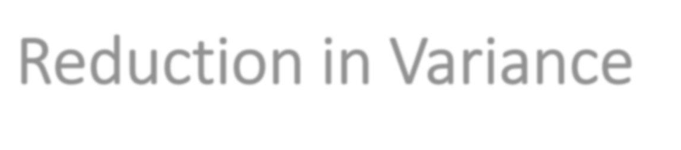

Reduction in Variance
Reduction in variance is an algorithm used for continuous target variables (regression problems). This algorithm uses the standard formula of variance to choose the best split. The split with lower variance is selected as the criteria to split the population:
Steps to calculate Variance:
Calculate variance for each node.
Calculate variance for each split as weighted average of each node variance.

Slide 22
Performance measures for Regression
1.Mean Squared Error(MSE) 2.Mean-Absolute-Error(MAE). 3.Root-Mean-Squared-Error(RMSE).
4. Mean Absolute Percentage Error (MAPE) 5.R² or Coefficient of Determination. 6.Adjusted R²

Slide 23
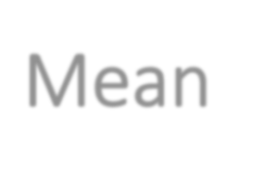
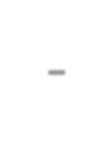
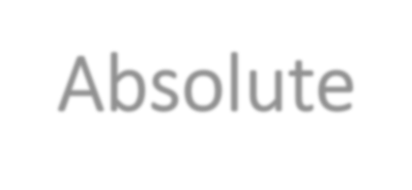
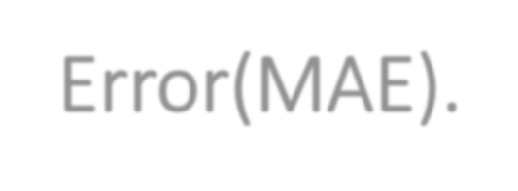
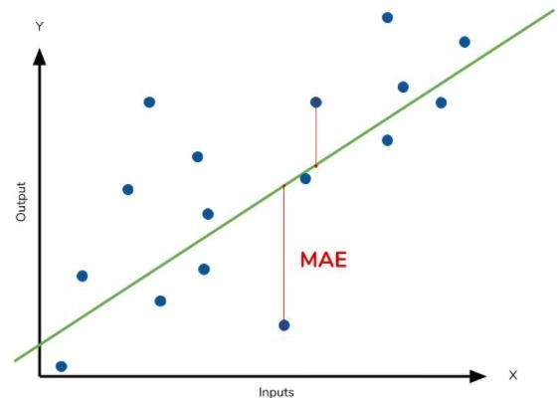
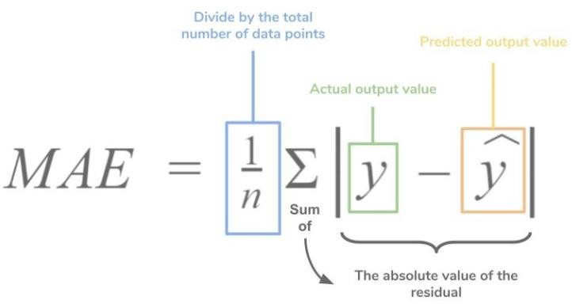
Mean-Absolute-Error(MAE).
It is measured by taking the average of the absolute difference between actual values and the predictions.
Suppose we have a model that predicted the salary of 4 employees which are $988,
$1943, $1239, $2124 where the actual salaries were $1000, $1500, $2000. $2500 respectively.
If we take the absolute difference of the predictions and the actual values we get:
| 1000 - 988 | = 12
| 1500 - 1943 | = 443
| 2000 - 1239 | = 761
| 2500 - 2124 | = 376
Now, MAE = (12 + 443 + 761 + 376) / 4 = 398
This value tells us that the model is predicting $398 more or less on average than the actual value.
**The less the value of MAE the better the performance of your model.

Slide 24
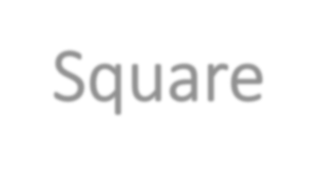
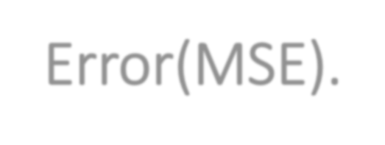
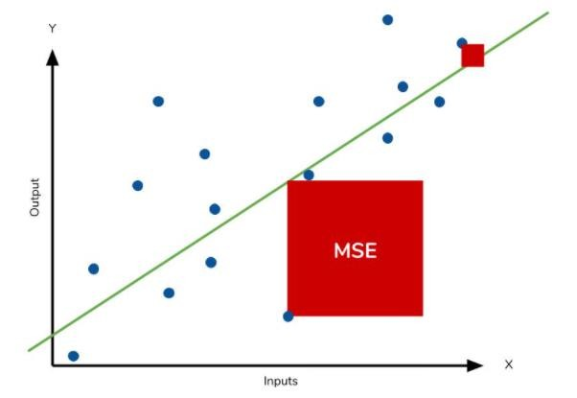
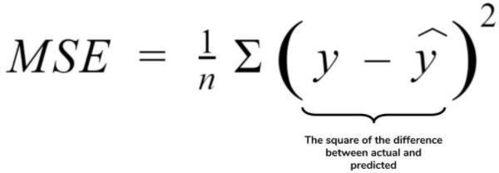
Mean-Square-Error(MSE).
The mean square error (MSE) is just like the MAE, but squares the difference before summing them all instead of using the absolute value. We can see this difference in the equation below.
MSE = (12^2 + 443^2 + 761^2 + 376^2)/4
= 229222.5
Because we are squaring the difference, the MSE will almost always be bigger than the MAE. For this reason, we cannot directly compare the MAE to the MSE. We can only compare our model’s error metrics to those of a competing model.
** Outliers will produce these exponentially larger differences

Slide 25
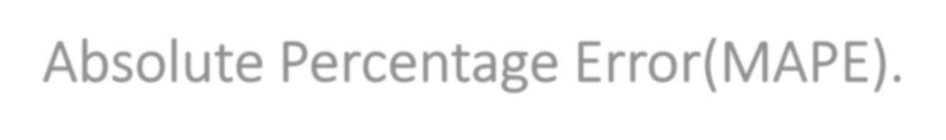
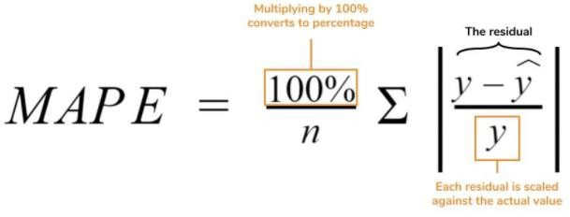
Mean-Absolute Percentage Error(MAPE).
The mean absolute percentage error (MAPE) is the percentage equivalent of MAE. The equation looks just like that of MAE, but with adjustments to convert everything into percentages.
MAPE= 100%/4*sum(12/1000+443/1500+761/2000+376/2500)
=21%
MAPE is how far the model’s predictions are off from their corresponding outputs on average. Like MAE, MAPE also has a clear interpretation since percentages are easier for people to conceptualize.
Predicted | Actual | Absolute Percentage Error
988 | 1000 | 1.2
1943 | 1500 | 29.53333333
1239 | 2000 | 38.05
2124 | 2500 | 15.04
 | MAPE | 20.95
** MAPE has managerial appeal and is a measure commonly used in forecasting. The smaller the MAPE the better the forecast.

Slide 26
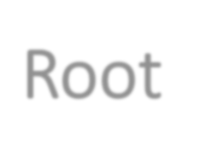
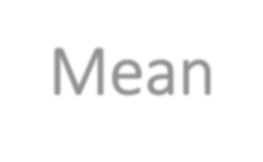
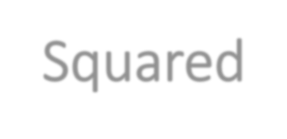
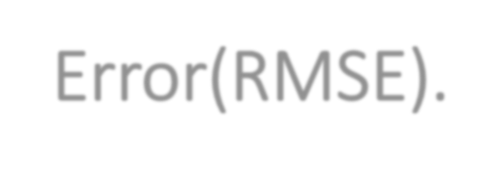
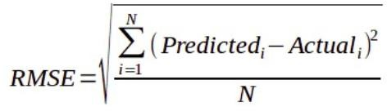
Root-Mean-Squared-Error(RMSE).
The Root Mean Square Error is measured by taking the square root of the average of the squared difference between the prediction and the actual value. It represents the sample standard deviation of the differences between predicted values and observed values(also called residuals).
RMSE = sqrt((12^2 + 443^2 + 761^2 + 376^2) /
4)
~478
Here the RMSE value is greater than that of MAE. This is because RMSE takes the square of the differences between the predictions and the actual value, hence the value is greater the MAE value.
Both MAE and RMSE are in the same units as the dependent variable. As compared to MAE, RMSE will give higher weight to the errors and punish large errors in the model.
**RMSE is a better performance metric as it squares the errors before taking the averages. For that, large errors receive higher punishment. It performs particularly well when large errors are undesirable for your model's performance. But RMSE is highly sensitive to outlier values(an outlier is a data point that differs significantly from other observations). Hence, prior to using this metric, you must remove the outliers from your data set.

